Slide 1

Regression Model Car price prediction web app
Steven L Truong
Friday, 16/04/2021

Slide 2
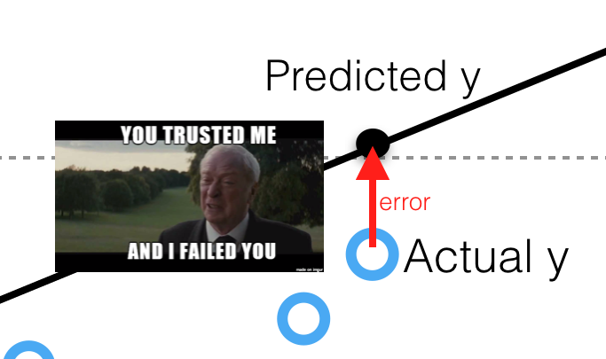

Slide 3

INTRODUCTION
MOTIVATION:
Buy and sell used cars is always a big decision.
Create the tools to predict the as closest car’s price as possible.
Notes:
Potential client offers opportunity to work with me.
Main objectives is to analyze the data to determine the top stations with the most traffic. Then, out of the top stations, deduce the most logical option based on not only the most crowded area, but also to answer the question that: what are the common venues around the neighborhood? Is it suitable to open the Vietnamese restaurant here?
Main goals: Using data science tools and analytical skills to extract useful information from raw data and logically present it to the client.

Slide 4
INTRODUCTION
MOTIVATION:
Buy and sell used cars is always a big decision.
Create the tools to predict the as closest car’s price as possible.
OBJECTIVES:
Build predictive models using data gathered from the internet.
Conclude the best model ready for production.
Notes:
Potential client offers opportunity to work with me.
Main objectives is to analyze the data to determine the top stations with the most traffic. Then, out of the top stations, deduce the most logical option based on not only the most crowded area, but also to answer the question that: what are the common venues around the neighborhood? Is it suitable to open the Vietnamese restaurant here?
Main goals: Using data science tools and analytical skills to extract useful information from raw data and logically present it to the client.

Slide 5
INTRODUCTION
MOTIVATION:
Buy and sell used cars is always a big decision.
Create the tools to predict the as closest car’s price as possible.
OBJECTIVES:
Build predictive models using data gathered from the internet.
Conclude the best model ready for production.
GOALS:
Write the web app and deploy the model to the cloud.
Notes:
Potential client offers opportunity to work with me.
Main objectives is to analyze the data to determine the top stations with the most traffic. Then, out of the top stations, deduce the most logical option based on not only the most crowded area, but also to answer the question that: what are the common venues around the neighborhood? Is it suitable to open the Vietnamese restaurant here?
Main goals: Using data science tools and analytical skills to extract useful information from raw data and logically present it to the client.

Slide 6

methodology
Data source:
Scrape from cars.com
Notes:
The main data source we will focus on is the MTA Turnstile data.
We also use Square API to explore surrounding venues of each station.
The tools we use are :
SQL for data storage and ingestion
Numpy and Pandas for data cleaning and manipulation
Matplotlib and Seaborn for plotting and visualizing
Other libraries: folium (map rendering), wordcloud (wordcloud generating), requests (handling url requests)

Slide 7







methodology
Data source:
Scrape from cars.com
Tools:
Numpy and Pandas
Matplotlib and Seaborn
Scikit-learn and XGBoost
Streamlit and Heroku
Notes:
The main data source we will focus on is the MTA Turnstile data.
We also use Square API to explore surrounding venues of each station.
The tools we use are :
SQL for data storage and ingestion
Numpy and Pandas for data cleaning and manipulation
Matplotlib and Seaborn for plotting and visualizing
Other libraries: folium (map rendering), wordcloud (wordcloud generating), requests (handling url requests)

Slide 8
methodology
Data Scraping and Preparation
Use BeaufulSoup to scrape data from cars.com
Clean the data to be ready for EDA
Notes:
Exploration:
We will pull the most recent 4 months of data (particularly from 11/28/2020 to 03/27/2021) and use SQL to ingest into jupyter notebook to clean and analyze.
Use Square API to pull data in json format into local machine. We are interested in the density of venues around the neighborhood (such as how many restaurants there are around this particular neighborhood; if so, what kind of cuisine are they? Are they Korean, Italian, American or Vietnamese?...) Is this block specialized in pizza? (You know Nyers love pizza, so they wouldn’t go to pizza block to try Vnese rest)
Preparation:
Almost every dataset is messy, so before going into graphing and seeking insights, we have to clean it. (Like dropping duplicates, change the datatypes, etc…)
Json (JS Object Notation) format is dictionary-like type of object, so we have to converse them into regular (tabular) dataframe to be consistent with our purpose.
Visualization:
We will be using tools in our disposal to create graphs (time series and bar charts) to see the trend of the data, and seek insights from them.
We also generate NYC map with traffic density and the venues wordclouds.

Slide 9
methodology
Data Scraping and Preparation
Use BeaufulSoup to scrape data from cars.com
Clean the data to be ready for EDA
Exploratory Analysis
Exploratory Data Analysis
Look at the features’ correlations for insights before modeling.
Notes:
Exploration:
We will pull the most recent 4 months of data (particularly from 11/28/2020 to 03/27/2021) and use SQL to ingest into jupyter notebook to clean and analyze.
Use Square API to pull data in json format into local machine. We are interested in the density of venues around the neighborhood (such as how many restaurants there are around this particular neighborhood; if so, what kind of cuisine are they? Are they Korean, Italian, American or Vietnamese?...) Is this block specialized in pizza? (You know Nyers love pizza, so they wouldn’t go to pizza block to try Vnese rest)
Preparation:
Almost every dataset is messy, so before going into graphing and seeking insights, we have to clean it. (Like dropping duplicates, change the datatypes, etc…)
Json (JS Object Notation) format is dictionary-like type of object, so we have to converse them into regular (tabular) dataframe to be consistent with our purpose.
Visualization:
We will be using tools in our disposal to create graphs (time series and bar charts) to see the trend of the data, and seek insights from them.
We also generate NYC map with traffic density and the venues wordclouds.

Slide 10
methodology
Data Scraping and Preparation
Use BeaufulSoup to scrape data from cars.com
Clean the data to be ready for EDA
Exploratory Analysis
Exploratory Data Analysis
Look at the features’ correlations for insights before modeling.
Modeling
Build baseline models.
Cross validation and choose the final model.
Notes:
Exploration:
We will pull the most recent 4 months of data (particularly from 11/28/2020 to 03/27/2021) and use SQL to ingest into jupyter notebook to clean and analyze.
Use Square API to pull data in json format into local machine. We are interested in the density of venues around the neighborhood (such as how many restaurants there are around this particular neighborhood; if so, what kind of cuisine are they? Are they Korean, Italian, American or Vietnamese?...) Is this block specialized in pizza? (You know Nyers love pizza, so they wouldn’t go to pizza block to try Vnese rest)
Preparation:
Almost every dataset is messy, so before going into graphing and seeking insights, we have to clean it. (Like dropping duplicates, change the datatypes, etc…)
Json (JS Object Notation) format is dictionary-like type of object, so we have to converse them into regular (tabular) dataframe to be consistent with our purpose.
Visualization:
We will be using tools in our disposal to create graphs (time series and bar charts) to see the trend of the data, and seek insights from them.
We also generate NYC map with traffic density and the venues wordclouds.

Slide 11

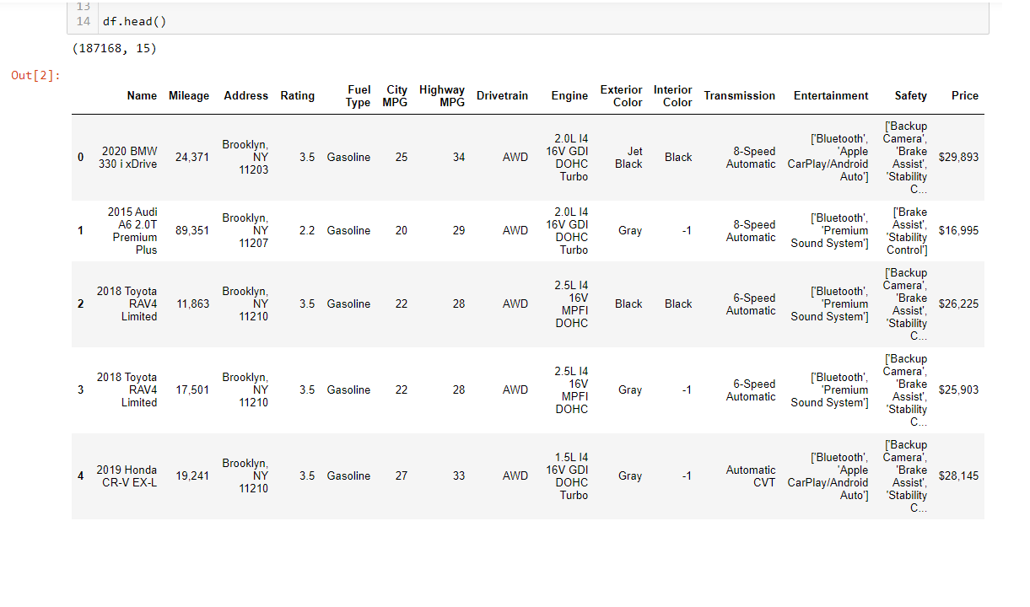
DATA CLEANING
Or we could say “cars cleaning”
Notes:
For our business’ purpose, we only focus on the traffic between 8AM-10PM since we want to open the restaurant, and it’s not very applicable to investigate the traffic from midnight to the early morning.
And the results we got: here are the top 5 stations with the most traffic presented by both color-coded bar chart and map.
If we look at the map, the bigger the circle, the more traffic that station has.
Here is the 34st – Penn Station with almost 5 millions turns, followed by 86 with a little over 3.5 million.

Slide 12

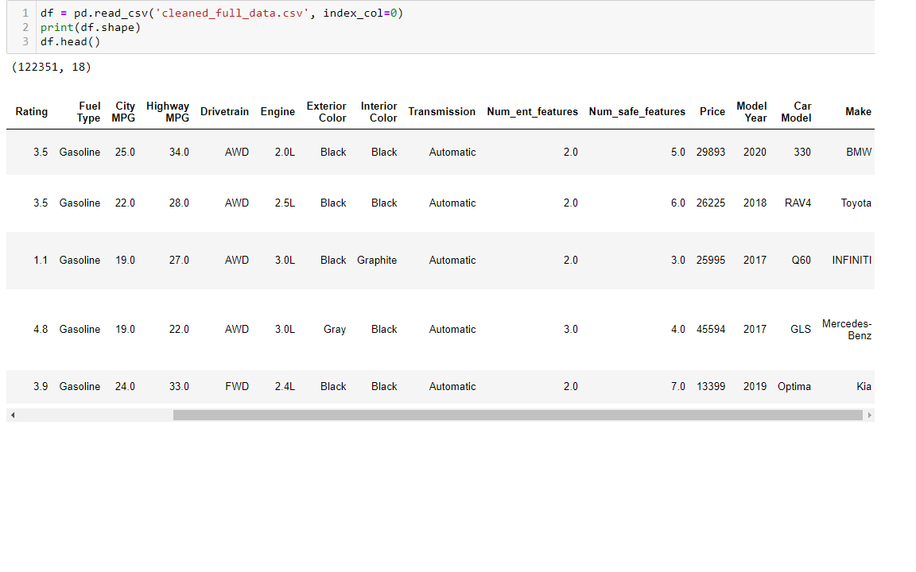
DATA CLEANING
Notes:
For our business’ purpose, we only focus on the traffic between 8AM-10PM since we want to open the restaurant, and it’s not very applicable to investigate the traffic from midnight to the early morning.
And the results we got: here are the top 5 stations with the most traffic presented by both color-coded bar chart and map.
If we look at the map, the bigger the circle, the more traffic that station has.
Here is the 34st – Penn Station with almost 5 millions turns, followed by 86 with a little over 3.5 million.

Slide 13
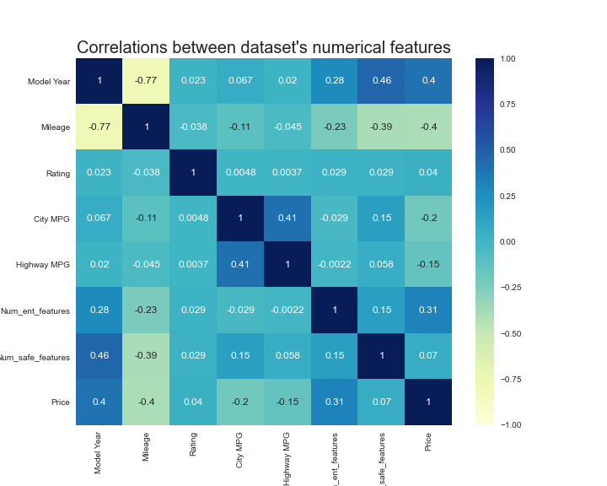
EDA
Price is positively correlated with Model Year and negatively correlated with Mileage.
Slightly positively correlated with num_ent_features.
Not so much for the rest of the features.
Notes:
For our business’ purpose, we only focus on the traffic between 8AM-10PM since we want to open the restaurant, and it’s not very applicable to investigate the traffic from midnight to the early morning.
And the results we got: here are the top 5 stations with the most traffic presented by both color-coded bar chart and map.
If we look at the map, the bigger the circle, the more traffic that station has.
Here is the 34st – Penn Station with almost 5 millions turns, followed by 86 with a little over 3.5 million.

Slide 14
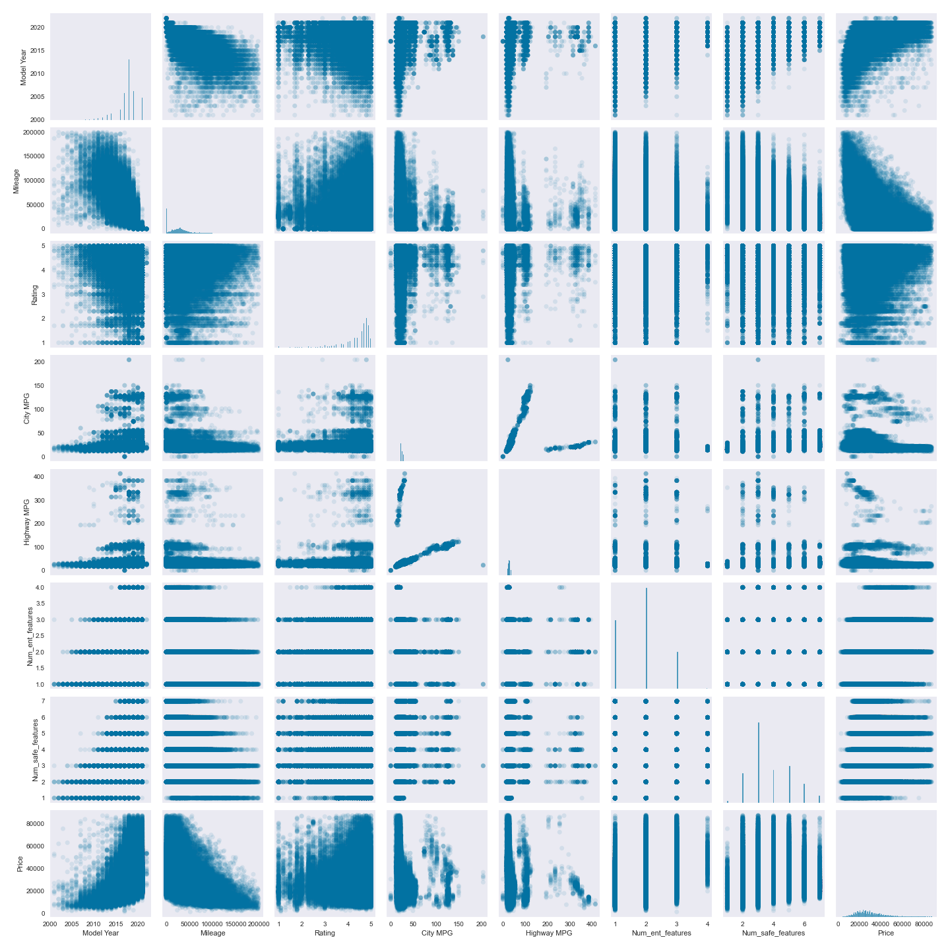
EDA
Price is positively correlated with Model Year and negatively correlated with Mileage.
Slightly positively correlated with num_ent_features.
Not so much for the rest of the features.
Notes:
For our business’ purpose, we only focus on the traffic between 8AM-10PM since we want to open the restaurant, and it’s not very applicable to investigate the traffic from midnight to the early morning.
And the results we got: here are the top 5 stations with the most traffic presented by both color-coded bar chart and map.
If we look at the map, the bigger the circle, the more traffic that station has.
Here is the 34st – Penn Station with almost 5 millions turns, followed by 86 with a little over 3.5 million.

Slide 15
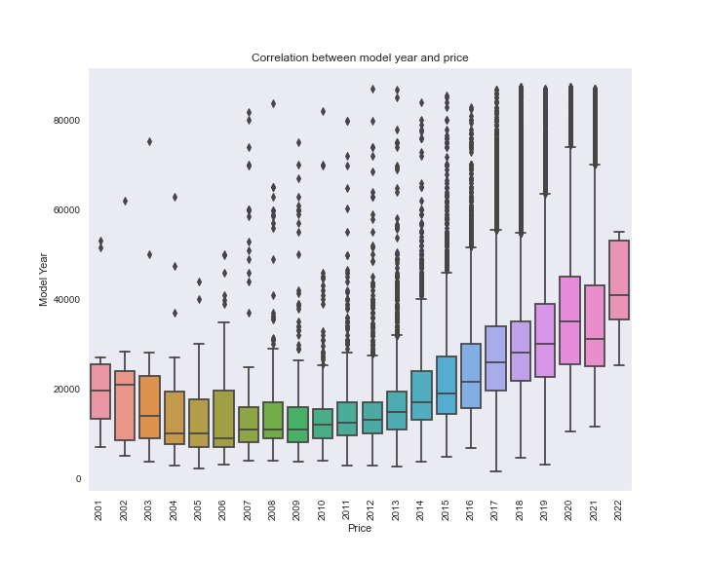
EDA
Price is positively correlated with Model Year.
There are outliers all over the place.
Generally speaking, the newer the more expensive car.
Notes:
For our business’ purpose, we only focus on the traffic between 8AM-10PM since we want to open the restaurant, and it’s not very applicable to investigate the traffic from midnight to the early morning.
And the results we got: here are the top 5 stations with the most traffic presented by both color-coded bar chart and map.
If we look at the map, the bigger the circle, the more traffic that station has.
Here is the 34st – Penn Station with almost 5 millions turns, followed by 86 with a little over 3.5 million.

Slide 16
MODELS
Pre features engineered.

Slide 17
MODELS
Pre features engineered.
Linear Regression Model:
R^2 for train set: 0.2968
R^2 for validation set: 0.2974
Polynomial Regression Model:
R^2 for train set: 0.477
R^2 for validation set: 0.470

Slide 18
MODELS
Pre features engineered.
Linear Regression Model:
R^2 for train set: 0.2968
R^2 for validation set: 0.2974
Polynomial Regression Model:
R^2 for train set: 0.477
R^2 for validation set: 0.470
Random Forest Regressor:
R^2 for train set: 0.581
R^2 for validation set: 0.577
Gradient Boosted Regressor:
R^2 for train set: 0.612
R^2 for validation set: 0.605
Extreme Gradient Boosting (XGBoost):
R^2 for train set: 0.763
R^2 for validation set: 0.732

Slide 19
MODELS
Pre features engineered.
Linear Regression Model:
R^2 for train set: 0.2968
R^2 for validation set: 0.2974
Polynomial Regression Model:
R^2 for train set: 0.477
R^2 for validation set: 0.470
Random Forest Regressor:
R^2 for train set: 0.581
R^2 for validation set: 0.577
Gradient Boosted Regressor:
R^2 for train set: 0.612
R^2 for validation set: 0.605
Extreme Gradient Boosting (XGBoost):
R^2 for train set: 0.763
R^2 for validation set: 0.732
In general, they all underfit

Slide 20
MODELS
Work with categorical features!

Slide 21
MODELS
Work with categorical features!
Intuitively, car’s brand determines the product’s price, so let’s work on that.

Slide 22
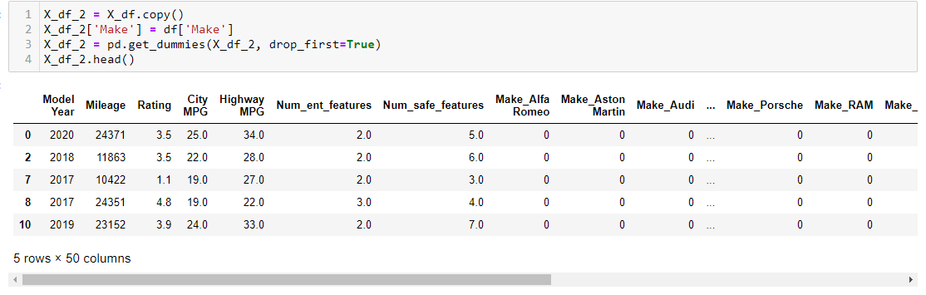
MODELS
Work with categorical features!
Intuitively, car’s brand determines the product’s price, so let’s work on that.

Slide 23
MODELS
Work with categorical features!
Linear Regression Model:
R^2 for train set: 0.503
R^2 for validation set: 0.505
Polynomial Regression Model:
R^2 for train set: 0.705
R^2 for validation set: 0.695
Extreme Gradient Boosting (XGBoost):
R^2 for train set: 0.873
R^2 for validation set: 0.870

Slide 24
MODELS
Work with categorical features!
Linear Regression Model:
R^2 for train set: 0.503
R^2 for validation set: 0.505
Polynomial Regression Model:
R^2 for train set: 0.705
R^2 for validation set: 0.695
Extreme Gradient Boosting (XGBoost):
R^2 for train set: 0.873
R^2 for validation set: 0.870
We have better results, can we improve our performance?

Slide 25
MODELS
Work with categorical features!
Let’s dummify the entire dataset!

Slide 26
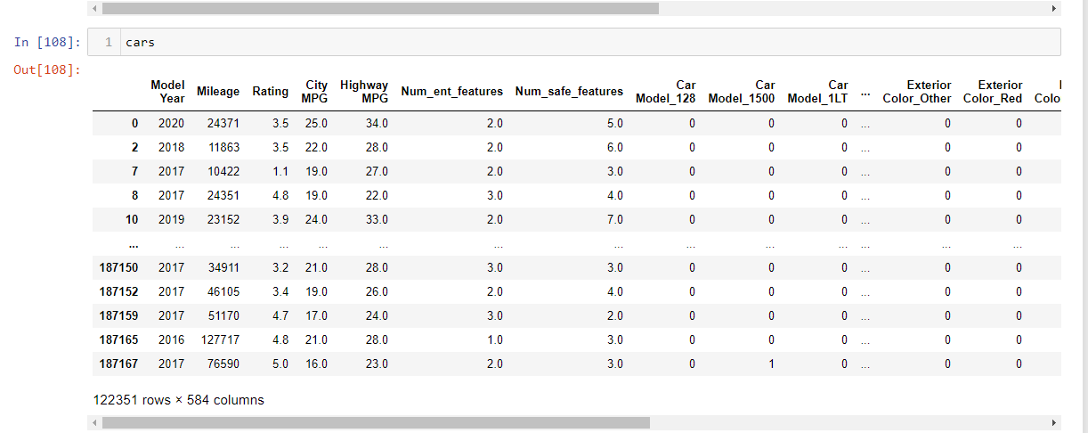
MODELS
Work with categorical features!
Let’s dummify the entire dataset!

Slide 27
MODELS
K-Fold Cross-Validation!
Linear Regression Model:
R^2 for train set: 0.871
R^2 for validation set: 869
RMSE = 4787.90
Lasso Model:
R^2 for train set: 0.870
R^2 for validation set: 866
Extreme Gradient Boosting (XGBoost):
R^2 for train set: 0.932
R^2 for validation set: 0.920
RMSE = 3749.5
Ridge Model:
R^2 for train set: 0.871
R^2 for validation set: 865

Slide 28
MODELS
K-Fold Cross-Validation!
Linear Regression Model:
R^2 for train set: 0.871
R^2 for validation set: 869
RMSE = 4787.90
Lasso Model:
R^2 for train set: 0.870
R^2 for validation set: 866
Extreme Gradient Boosting (XGBoost):
R^2 for train set: 0.932
R^2 for validation set: 0.920
RMSE = 3749.5
Ridge Model:
R^2 for train set: 0.871
R^2 for validation set: 865

Slide 29
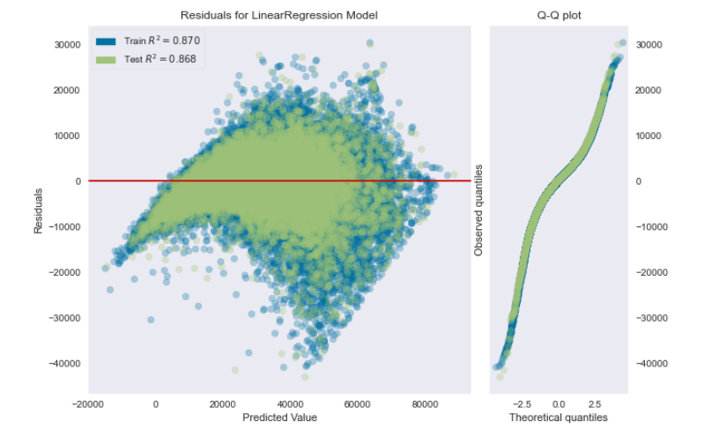
RESIDUALS
Linear Regression Model:
R^2 for train set: 0.871
R^2 for validation set: 869
RMSE = 4787.90

Slide 30
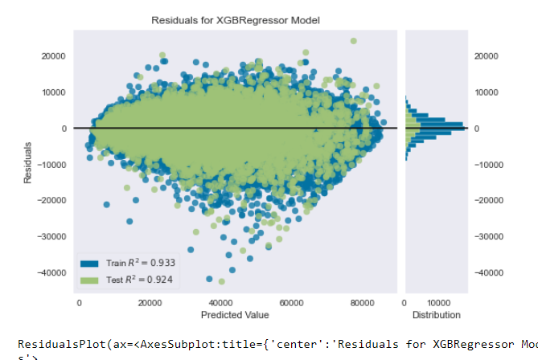
RESIDUALS
Extreme Gradient Boosting (XGBoost):
R^2 for train set: 0.932
R^2 for validation set: 0.920
RMSE = 3749.5

Slide 31
WHAT’S NEXT?

Slide 32
BUILD THE INTERACTIVE WEB APP AND DEPLOY IT TO THE CLOUD!

Slide 33
BUILD THE INTERACTIVE WEB APP AND DEPLOY IT TO THE CLOUD!
https://car-predictor-regression.herokuapp.com/

Slide 34
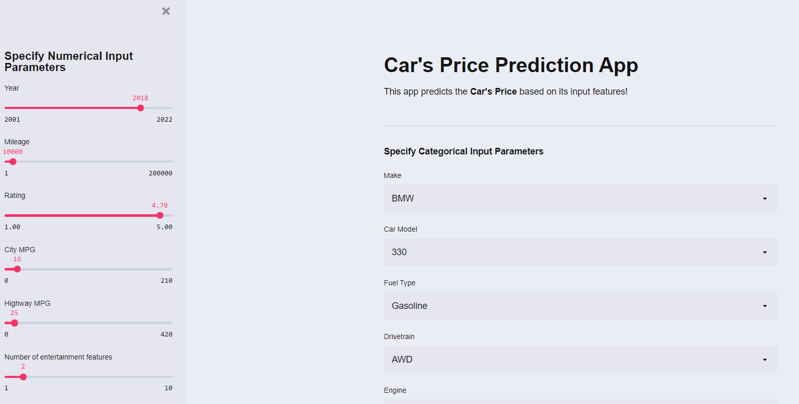
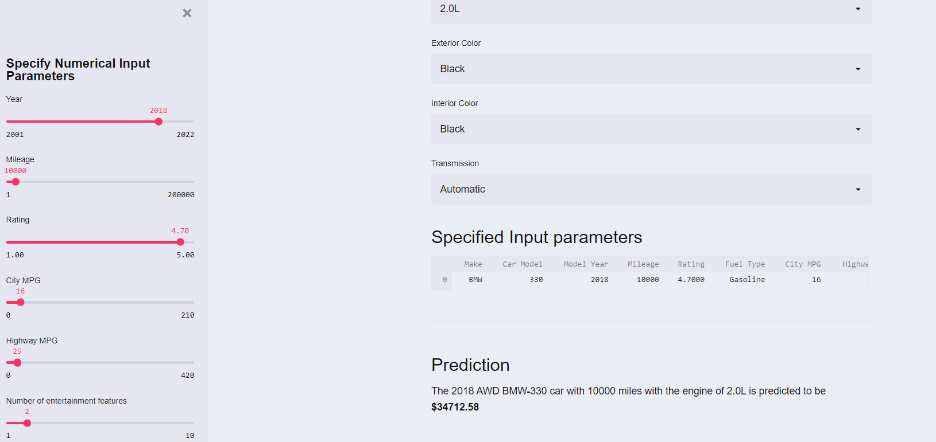
BUILD THE INTERACTIVE WEB APP AND DEPLOY IT TO THE CLOUD!
https://car-predictor-regression.herokuapp.com/

Slide 35



THANK YOU
Questions?
STEVEN L TRUONG
https://github.com/luongtruong77
tqluong77@gmail.com

Slide 36
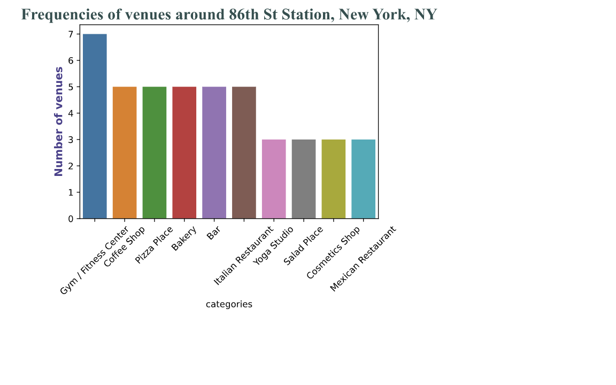
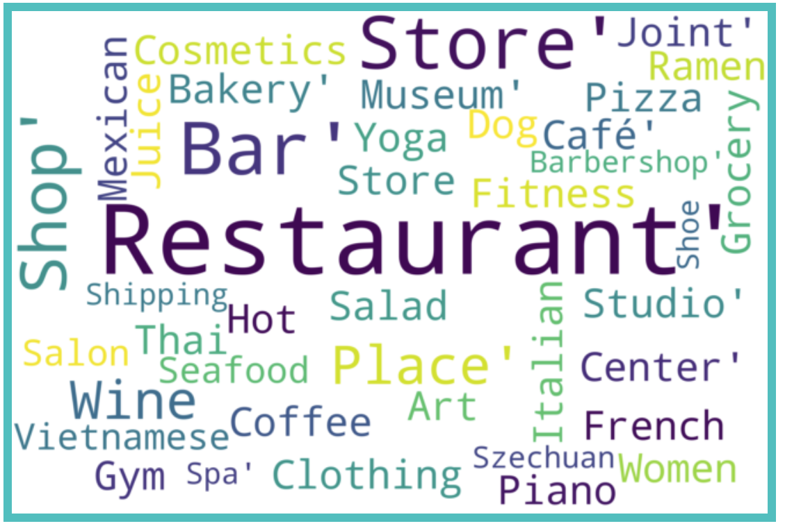
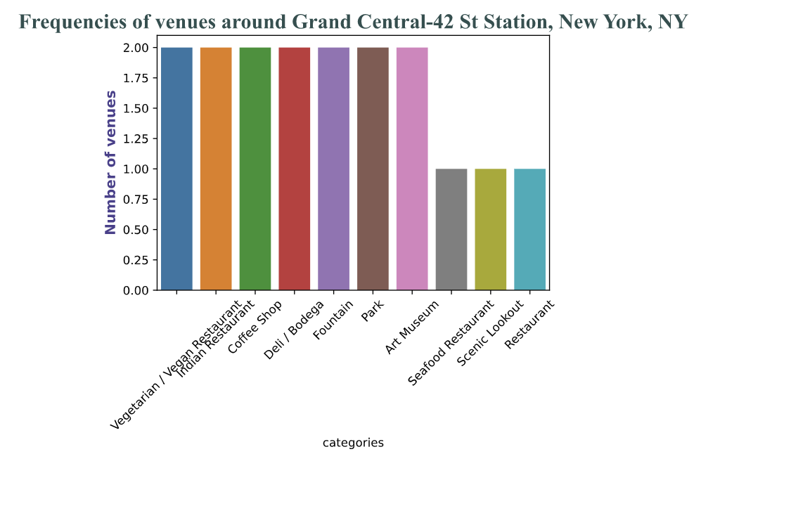
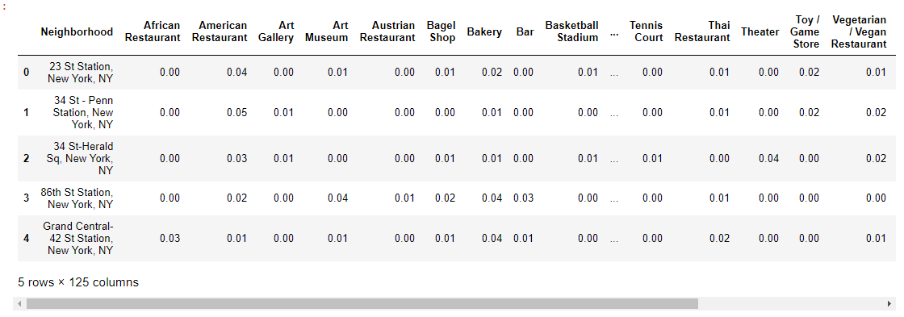
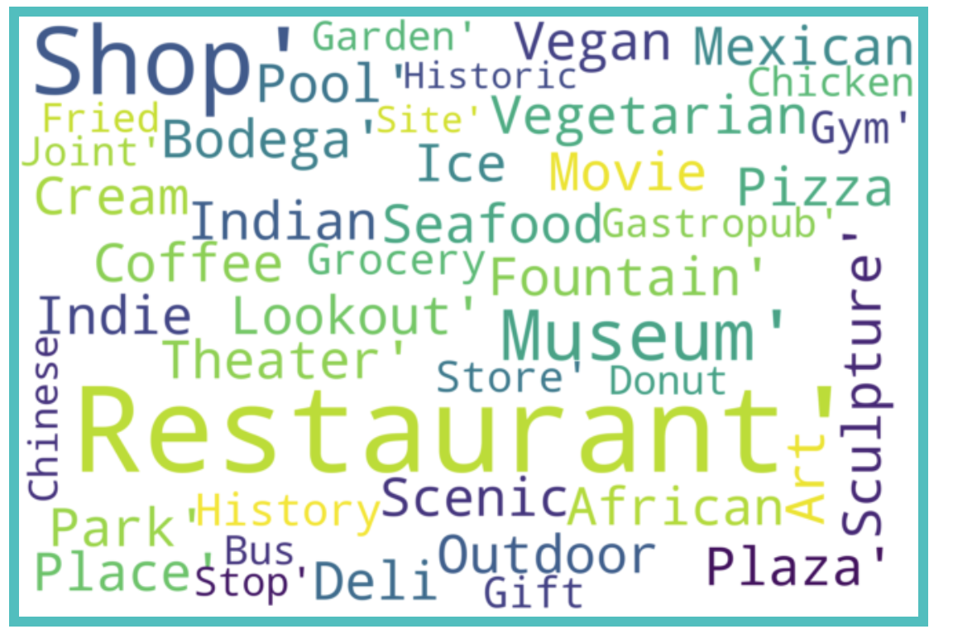
APPENDIX
Bar plots for the other 2 top stations along with their word clouds
Table of the 10 most common venues around top 5 stations

Slide 37
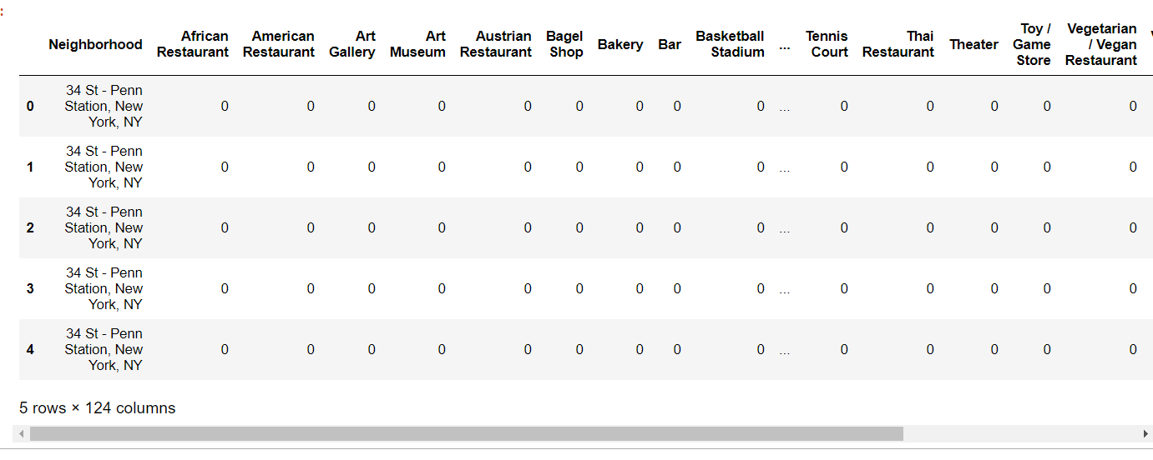
APPENDIX
First few rows of one hot encoding the neighborhood for each station
Documentation on how to use Square API to explore nearby venues given the neighborhood’s coordinates (latitude and longitude): https://developer.foursquare.com/docs/api-reference/venues/explore/

